Slide 1


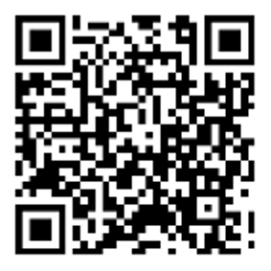

Metabolites: Organellar communication in health and disease
May 11–13, 2025 – Sitges, Spain
Extended abstract submission deadline:
February 14, 2025
Keynote speakers:
Navdeep Chandel, USA
Heather Christofk, USA
Speakers:
Monther Abu-Remaileh, USA
Kivanc Birsoy, USA
Donita Brady, USA
Elvan Boke, Spain
Guido Bommer, Belgium
Lulu Cambronne, USA
Mark Febbraio, Australia
Pekka Katajisto, Finland
Judith Klumperman, Netherlands
Natalie Krahmer, Germany
James Olzmann, USA
Rushika Perera, USA
Bao-Liang Song, China
Jessica Spinelli, USA
Phillip White, USA
Roberto Zoncu, USA
Antonio Zorzano, Spain
Early registration deadline:
March 28, 2025
Organizers:
Kivanc Birsoy, The Rockefeller University, USA
Roberto Zoncu, Berkeley Research, University of California, USA
Krista Bledsoe, Senior scientific editor, Molecular Cell
Allyson Evans, Editor-in-Chief, Cell Metabolism
cell-symposia.com/metabolites-2025

